Slide 1
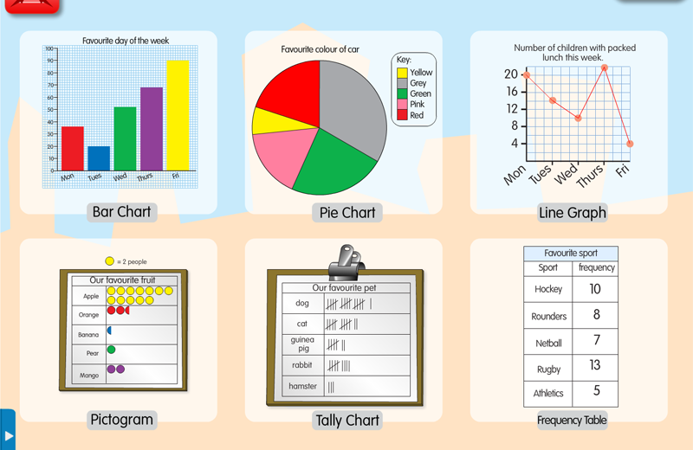

Diagrams, tables, bar charts …
YOUR LOGO
N.N.Korelina
Notes:
© Copyright Showeet.com – Creative & Free PowerPoint Templates

Slide 2
Задание 40 проверяет умение строить развернутое высказывание-рассуждение в соответствии с коммуникативной задачей и в заданном объеме
Notes:
© Copyright Showeet.com – Creative & Free PowerPoint Templates

Slide 3
Предлагается следующая коммуникативная ситуация: участник экзамена
выполняет проектную работу на указанную тему
выразить свое мнение
1
4
привести свои рассуждения по теме проекта
2
нашел статистические данные по теме
5
должен их прокомментировать
3
Notes:
© Copyright Showeet.com – Creative & Free PowerPoint Templates

Slide 4
Задание 40 – альтернативное, есть возможность выбрать одну из двух предложенных тем: одна тема строится на таблице, другая – на диаграмме
Notes:
© Copyright Showeet.com – Creative & Free PowerPoint Templates

Slide 5
Развернутое письменное высказывание с элементами рассуждения на основе таблицы/диаграммы по предложенной теме проектной работы
Задание 40
Выносятся на контроль метапредметные умения в предметных заданиях
Работа с разными источниками информации, в том числе несплошными текстами, таблицами и диаграммами – часть обучения иностранному языку (ФГОС нового поколения)
Необходимо оперативно сделать эту работу частью урока английского языка
Эффективно использовать мини-задания на вербализацию/описание таблиц и диаграмм

Slide 6
Развернутое письменное высказывание с элементами рассуждения на основе таблицы/диаграммы по предложенной теме проектной работы
Задание 40
Высокий уровень сложности
В 2022 году будут только таблицы и диаграммы как в демоверсии, других графиков не будет
5 пунктов плана – 5 абзацев
Числительные пишем цифрами

Slide 7
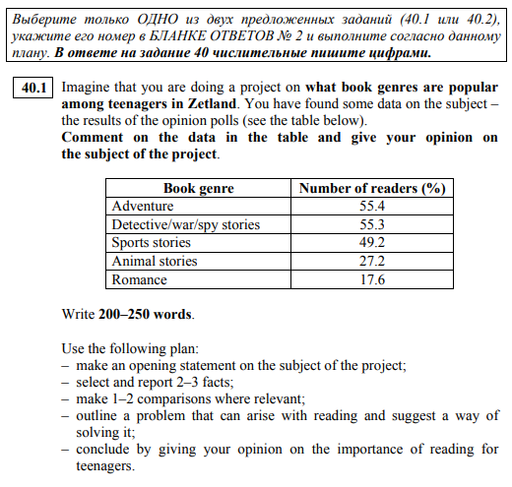
Демонстрационный вариант
Задание 40.1

Slide 8
Высказывание-рассуждение
Задание 40
Вступление: вводный тезис общего характера по выбранной теме с обозначения коммуникативной ситуации и целей выполняемого проекта
Основная часть: - описать приведенную статистику, выделив 2-3 основные черты; - провести 1-2 сравнения в рамках темы; - обрисовать проблему, которая может возникнуть в исследуемой сфере и предложить пути ее решения
Заключение: выразить свое мнение по теме проекта

Slide 9
Высказывание-рассуждение
Задание 40
В высказывании желательно написать обо всех данных из таблицы/диаграммы
Последний пункт и заключение в разных темах формулируются по-разному!

Slide 10
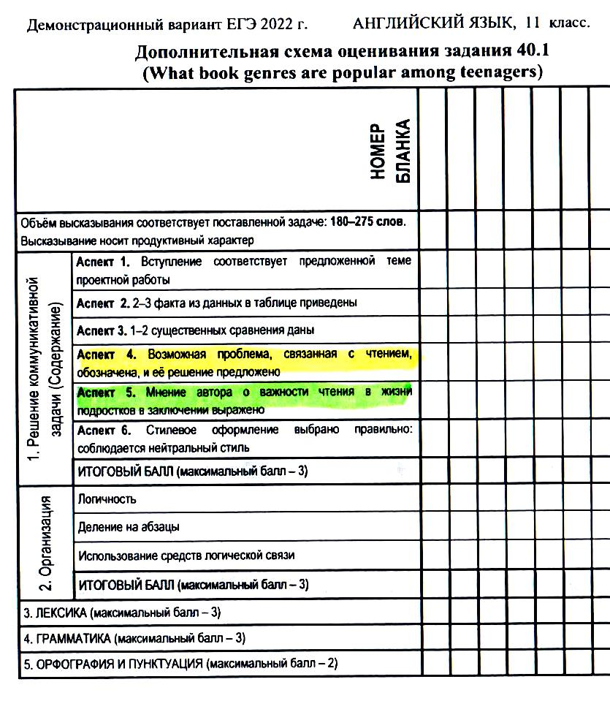
Демонстрационный вариант
Задание 40.1

Slide 11
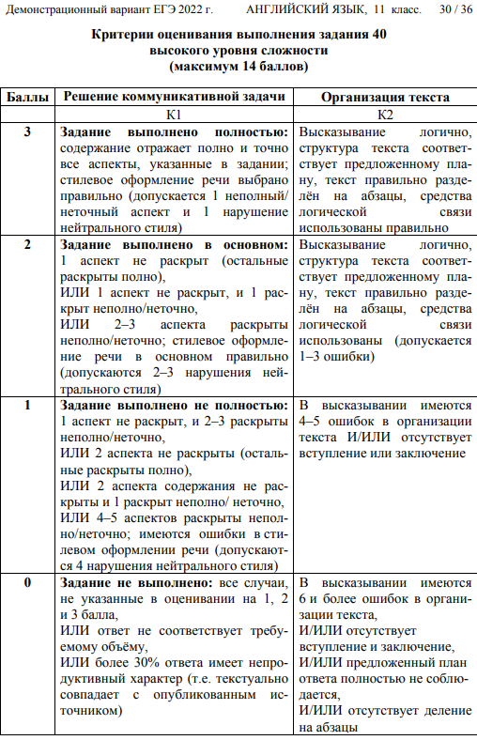
Задание 40

Slide 12
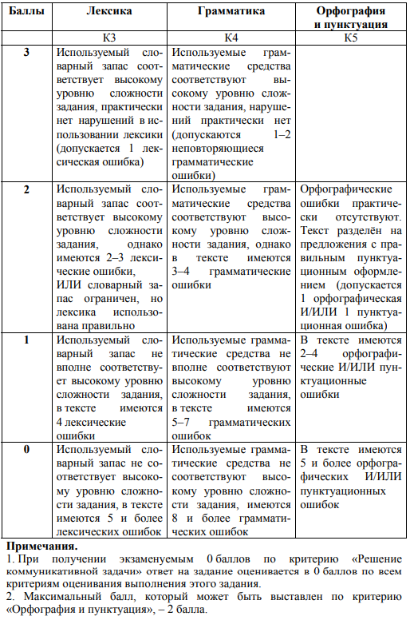
Задание 40

Slide 13
Появление в ЕГЭ волшебной страны Zetland
Необходимо выполнить проект о … на основе данных. Это могут быть данные из любого источника, любого города или страны. Zetland – Z страна/город (которая, как сообщают Интернет и разнообразные энциклопедии является пригородом Сиднея) – т.е. вымышленная. В одном из видео заместитель Вербицкой М.В. упоминает: "Мнение не должно быть связано со статистикой, а с темой проекта в целом!" Есть статистика и есть тема проекта. Актуальным является её изучение! Название страны/города роли не играет. Это условная единица.

Slide 14
Демонстрационный вариант
Задание 40.1

Slide 15
- make an opening statement on the subject of the project
дать понять о чем ваш письменный ответ +
упомянуть проект и указать тему проекта +
подчеркнуть ее важность/ актуальность +/-
упомянуть данные из таблицы/ диаграммы +
обозначить цель проекта +/-

Slide 16
- make an opening statement on the subject of the project
Задание 40.1
Recent studies show that (актуальность, тренды). While doing my own project on (тема проекта), I found some (relevant) data (that illustrate what / how (тема проекта)), and in this essay I am going to analyze this data and express my opinion on … / present my conclusions.

Slide 17
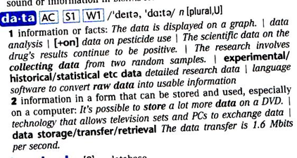
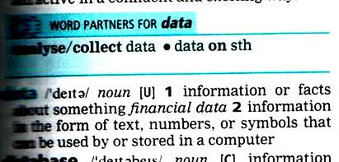
data
Longman Exams Dictionary:
Cambridge Learner’s Dictionary

Slide 18
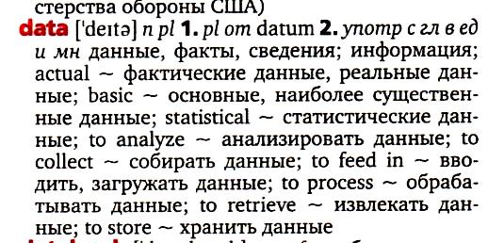
data
Comprehensive English-Russian Dictionary:

Slide 19
- make an opening statement on the subject of the project
Задание 40.1
… has been the subject of numerous studies over the last few decades. As part of my own project on (an important topic of) (тема проекта), I have found some relevant data and come across quite interesting/ surprising findings.

Slide 20
- make an opening statement on the subject of the project
Задание 40.1
Many people believe that (общепринятое/спорное утверждение, связанное с темой проекта). The aim of the project I am currently doing/working on is to find out more about it. As part of my project, I have found and analyzed some data on … .

Slide 21
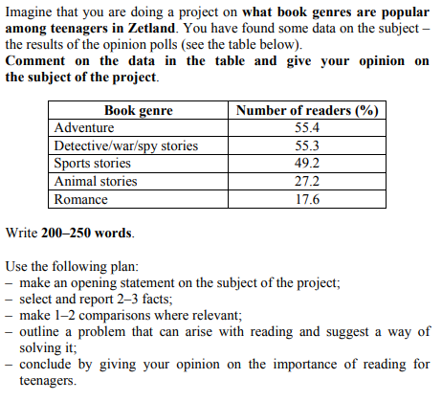
- make an opening statement on the subject of the project
Many people believe that teenagers are no longer interested in reading. The aim of the project I am currently doing/working on is to find out more about it. As part of my project, I have found and analyzed some data on what literary genres are popular with teenagers living in Zetland.
Notes:
© Copyright Showeet.com – Creative & Free PowerPoint Templates

Slide 22
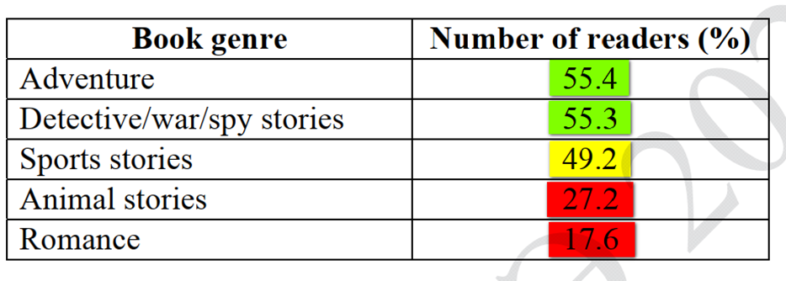
- select and report 2 – 3 facts
изучить таблицу
сгруппировать данные – 2-3 группы: самые популярные, средние по популярности, наименее популярные (Демо 2022, 40.1)
назвать и описать эти 2-3 черты в общем виде

Slide 23
- select and report 2 – 3 facts
According to the data, teenagers in Zetland have quite a wide range of tastes when it comes to genres of literature. 1) The vast majority of the respondents enjoy reading adventure and detective stories as well as books about war and spies. 2) Sports stories are also quite popular with teenage readers in Zetland, 3) whereas romantic novels appear to be the least popular book genre.

Slide 24
- make 1 – 2 comparisons where relevant
сравнить данные между собой
детализировать – качественно охарактеризовать: добавить проценты/количество – насколько больше/меньше; значительная/несуществен-ная разница между … и …; ожидаемое/неожиданное

Slide 25
- make 1 – 2 comparisons where relevant
The most striking feature is …
Another factor worth mentioning is…
- The most significant difference can be observed between … and …
- It is apparent / notable that …

Slide 26

- make 1 – 2 comparisons where relevant
Surprisingly, only 27.2% and 17.6% of those surveyed/polled enjoy reading animal stories and romance. By contrast, adventure novels are favoured by a much higher proportion of the respondents (55.4%, to be exact), followed closely by detective, war and spy stories at 55.3%. The percentage of those who like reading sports stories is only slightly lower, making up 49.2%.

Slide 27

- outline a problem that can arise with reading and suggest a way of solving it
найти проблему – она должна быть связана с темой
предложить решение проблемы

Slide 28
- outline a problem that can arise with reading and suggest a way of solving it
One problem that can/might arise is …
One of the problems that is/can be caused by ___ is …
One problem that can occur in ___ is …
One problem that can occur as a result of ___ is …
One problem that smartphone users often face / are confronted with is …
One problem (that is usually/often) associated with ___ is …
One problem that is often experienced by readers …
The best way to solve this problem is to …
One of the best ways to tackle this issue is …

Slide 29
- outline a problem that can arise with reading and suggest a way of solving it
One difficulty that struggling readers often have is / that teenage readers often face is lack of motivation to read. It is a serious problem that affects the development of comprehension skills and overall academic performance.

Slide 30
- outline a problem that can arise with reading and suggest a way of solving it
One problem that is nowadays associated with reading is a growing decline in book-reading culture. Indeed reading books seems to be losing its popularity with people of all ages, including teenagers .

Slide 31
- outline a problem that can arise with reading and suggest a way of solving it
The data indicate that although modern teenagers read a lot, they tend to avoid choosing romantic novels and animal stories. I suppose this is because today’s adolescents are too pragmatic, not caring and compassionate enough. One solution to this problem is for parents and teachers to raise teenagers’ awareness of the importance of developing empathy and encourage them to read and discuss romance and animal stories. The best way to do it is to find out what puts young people off choosing these genres and try to connect reading to their interests.

Slide 32
- outline a problem that can arise with reading and suggest a way of solving it
Although teenagers in Zetland seem to be interested in reading, globally, young people are reading fewer books than before. The problem is that today's teenagers get easily discouraged by long and challenging texts. As a result, they feel frustrated and lose motivation to read, which affects the development of their comprehension skills and overall academic performance. The best solution to this problem is to let teenagers choose their reading for themselves and encourage them to read different texts, not only books.

Slide 33
- conclude by giving your opinion on the importance of reading for teenagers
сделать заключение
свести все ключевые моменты воедино – although/while

Slide 34
- conclude by giving your opinion on the importance of reading for teenagers
In conclusion, I believe that although not all literature genres are liked by Zetland’s teenagers, reading obviously plays a significant role in their lives and in the life of every teenager.

Slide 35
- conclude by giving your opinion on the importance of reading for teenagers
In conclusion, I firmly believe that despite some problems associated with reading / that reading might cause, it obviously plays a significant role in the life of every teenager.

Slide 36
- conclude by giving your opinion on the importance of reading for teenagers
Задание 40.1
In conclusion, I firmly believe that despite some problems associated with reading, it is obviously very important for teenagers to read on a regular basis / different texts / books of different genres.

Slide 37
Recent studies show that teenagers’ reading habits have changed. To find out more about it, I have collected some information on what literary genres are popular with teenagers living in Zetland. As part of my project, I have analyzed these data and come across some interesting findings.
According to the data, teenagers in Zetland have quite a wide range of tastes when it comes to genres of literature. The vast majority of the respondents enjoy reading adventure and detective stories as well as books about war and spies. Sports stories are also quite popular with teenage readers in Zetland whereas romantic novels are the least popular book genre.
Surprisingly, only 27.2% and 17.6% of those surveyed like reading animal stories and romance. By contrast, adventure novels are favoured by a much higher proportion of the respondents (55.4%, to be exact), followed closely by detective, war and spy stories at 55.3% The percentage of those who enjoy reading sports stories is only slightly lower, making up 49.2%.
Although teenagers in Zetland seem to be interested in reading, globally, young people are reading fewer books than before. The problem is that today's teenagers get easily discouraged by long and challenging texts. As a result, they feel frustrated and lose motivation to read, which affects the development of their comprehension skills and academic performance. The best solution to this problem is to let teenagers choose their reading for themselves and encourage them to read not only books but a variety of texts / to read on a regular basis.
In conclusion, I firmly believe that despite some problems associated with reading, it is obviously very important for teenagers to regularly read different texts (and books of different genres).

Slide 38
Recent studies show that teenagers’ reading habits have changed. To find out more about it, I have collected some information on what literary genres are popular with teenagers living in Zetland. As part of my project, I have analyzed these data and come across some interesting findings.
According to the data, teenagers in Zetland have quite a wide range of tastes when it comes to genres of literature. The vast majority of the respondents enjoy reading adventure and detective stories as well as books about war and spies. Sports stories are also quite popular with teenage readers in Zetland whereas romantic novels are the least popular book genre.
Surprisingly, only 27.2% and 17.6% of those surveyed like reading animal stories and romance. By contrast, adventure novels are favoured by a much higher proportion of the respondents (55.4%, to be exact), followed closely by detective, war and spy stories at 55.3% The percentage of those who enjoy reading sports stories is only slightly lower, making up 49.2%.
Although teenagers in Zetland seem to be interested in reading, globally, young people are reading fewer books than before. The problem is that today's teenagers get easily discouraged by long and challenging texts. As a result, they feel frustrated and lose motivation to read, which affects the development of their comprehension skills and academic performance. The best solution to this problem is to let teenagers choose their reading for themselves and encourage them to read on a regular basis.
In conclusion, I firmly believe that despite some problems associated with reading, it is obviously very important for teenagers to regularly read different texts .

Slide 39
Recent studies show that teenagers’ reading habits have changed. To find out more about it, I have collected some information on what literary genres are popular with teenagers living in Zetland. As part of my project, I have analyzed these data and come across some interesting findings.
According to the data, teenagers in Zetland have quite a wide range of tastes when it comes to genres of literature. The vast majority of the respondents enjoy reading adventure and detective stories as well as books about war and spies. Sports stories are also quite popular with teenage readers in Zetland whereas romantic novels are the least popular book genre.
Surprisingly, only 27.2% and 17.6% of those surveyed like reading animal stories and romance. By contrast, adventure novels are favoured by a much higher proportion of the respondents (55.4%, to be exact), followed closely by detective, war and spy stories at 55.3% The percentage of those who enjoy reading sports stories is only slightly lower, making up 49.2%.
Although teenagers in Zetland seem to be interested in reading, globally, young people are reading fewer books than before. The problem is that today's teenagers get easily discouraged by long and challenging texts. As a result, they feel frustrated and lose motivation to read, which affects the development of their comprehension skills and academic performance. The best solution to this problem is to let teenagers choose their reading for themselves and encourage them to read not only books but a variety of texts.
In conclusion, I firmly believe that despite some problems associated with reading, it is obviously very important for teenagers to regularly read different texts.

Slide 40
Many thanks to E.S.Kapturova
В презентации использованы материалы вебинара «ЕГЭ-2022: как подготовить к заданиям нового формата», который состоялся 18 октября 2021 г. и презентации «Эссе на основе таблиц и диаграмм. Задание 40, ЕГЭ 2022», автор – Каптурова Евгения Сергеевна, канд. пед. наук, доцента ФГБОУ ВО «ОГУ им. И.С. Тургенева», ведущий эксперт ЕГЭ и ОГЭ, член NATE
Notes:
© Copyright Showeet.com – Creative & Free PowerPoint Templates

Slide 41
Thank You !
Hope you like this presentation!
Notes:
© Copyright Showeet.com – Free PowerPoint Templates

